Slide 1
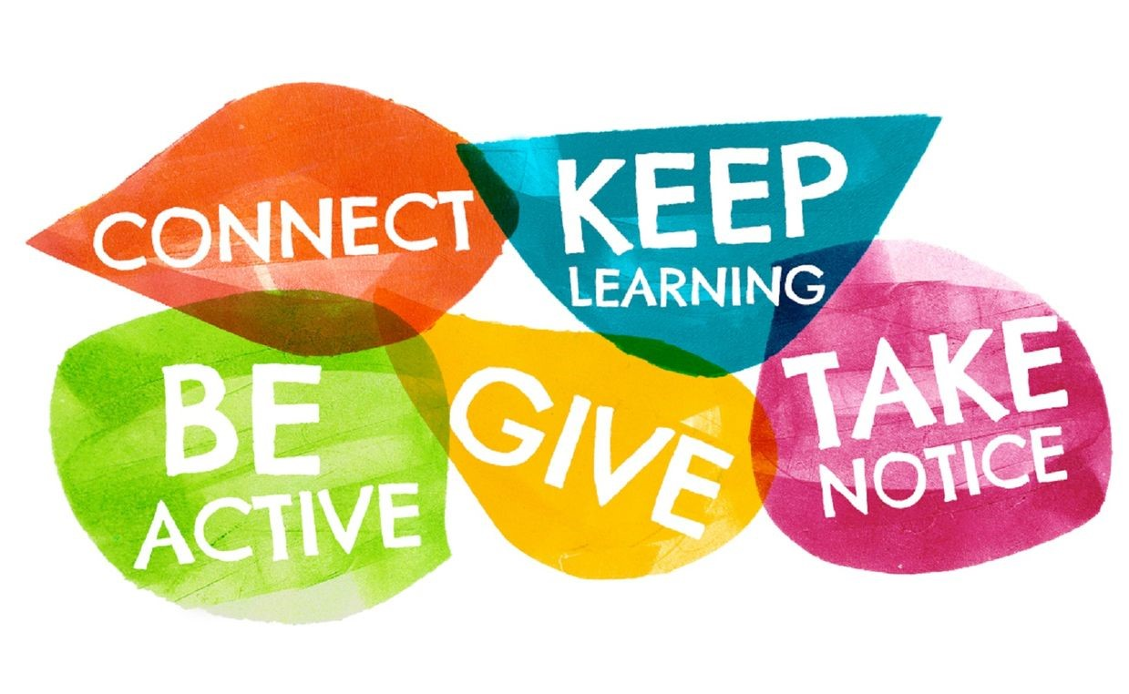

Slide 2

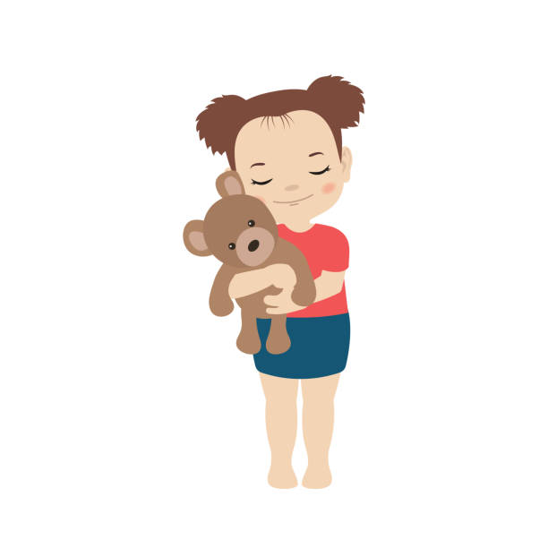
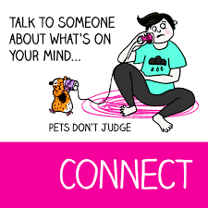

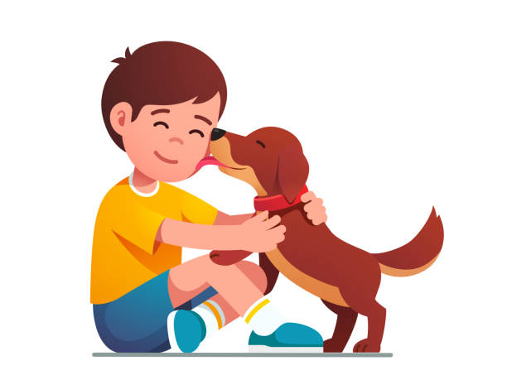
Connecting is not just for humans there are many objects that can do the same.

Slide 3

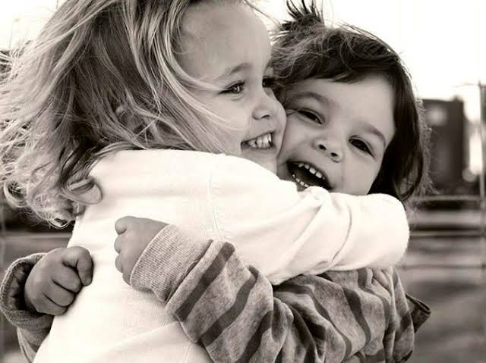
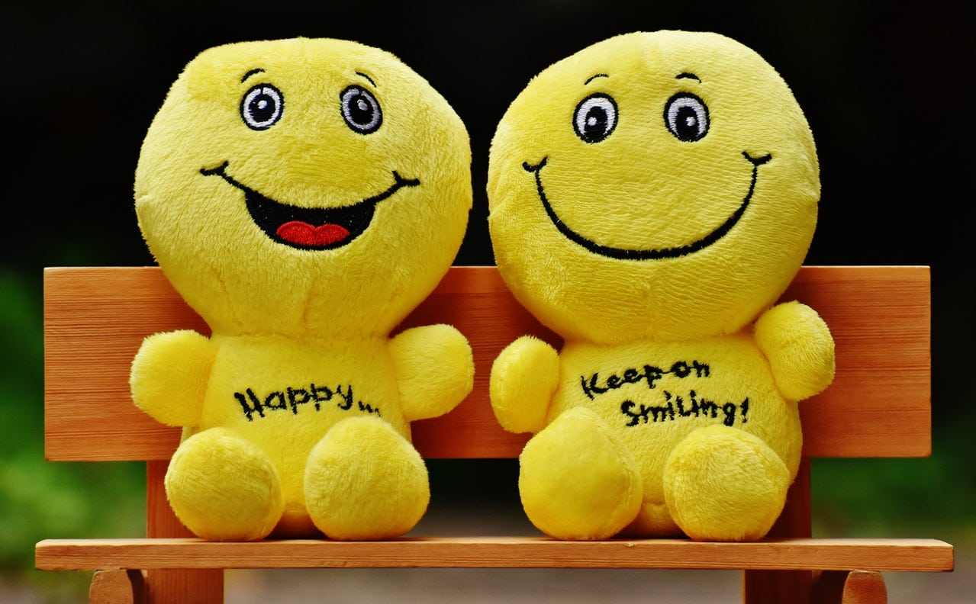
If you see someone without a smile give them one of yours!

Slide 4
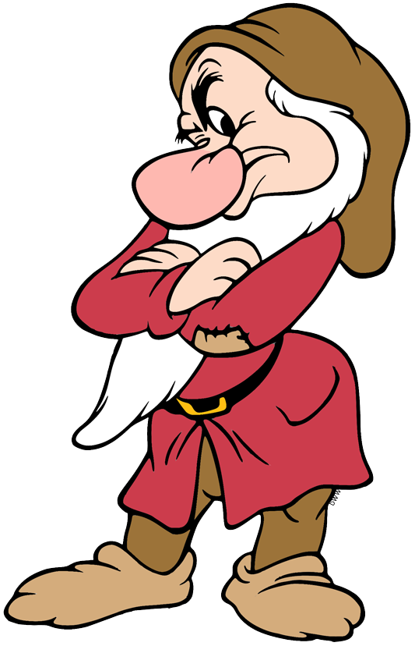
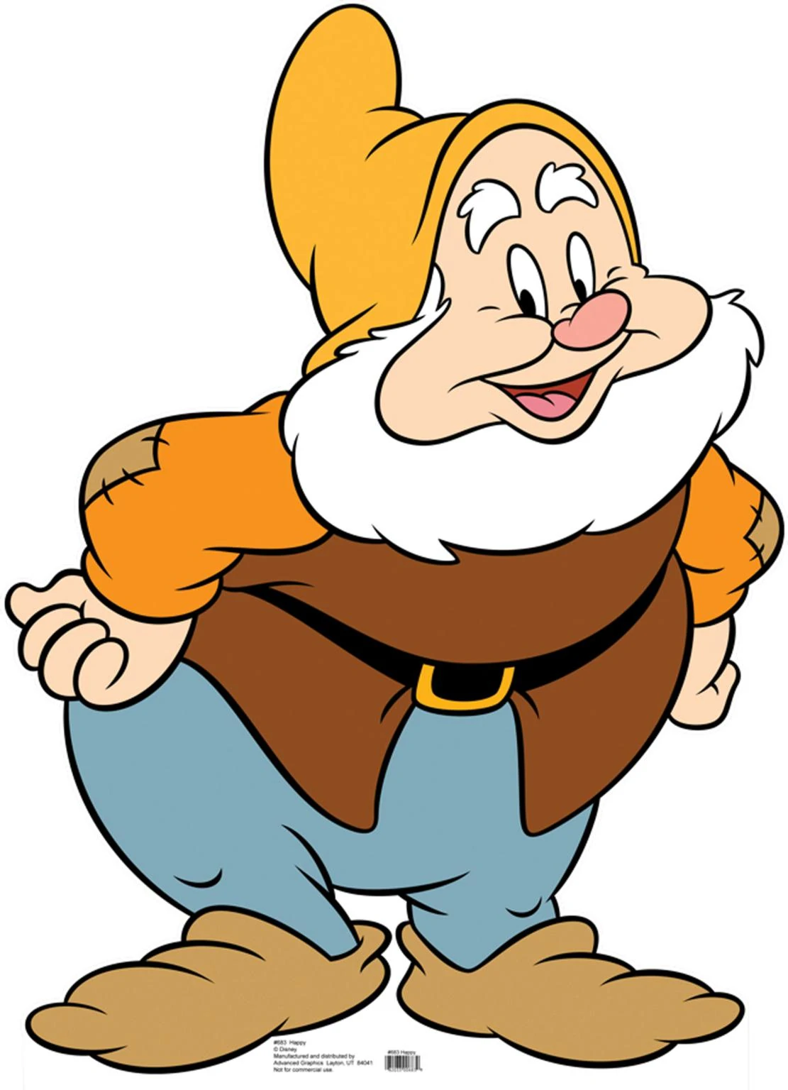
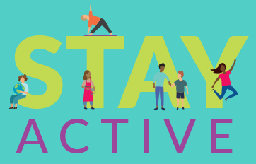
Inactive
Unable to cope
Overwhelmed
Bored
Frustrated
Unhealthy
Closed mind set
Active
Able to cope
Relaxed
Excited
Calm
Healthy
Open mind

Slide 5

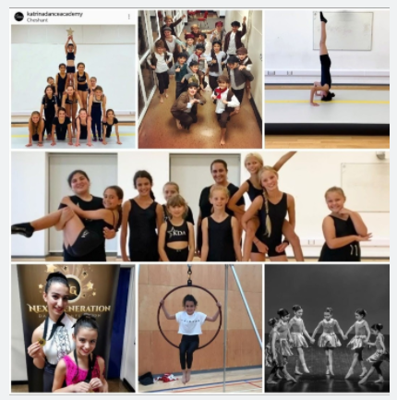

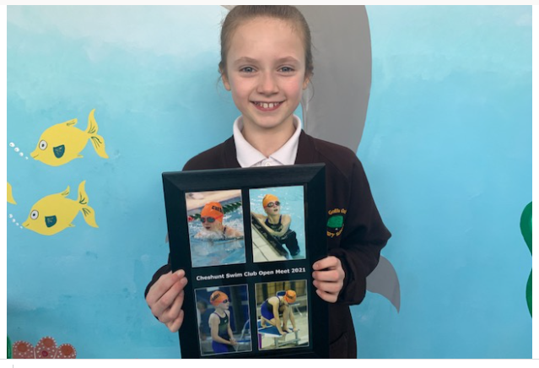

Slide 6

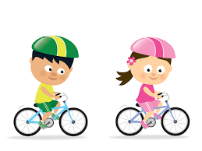
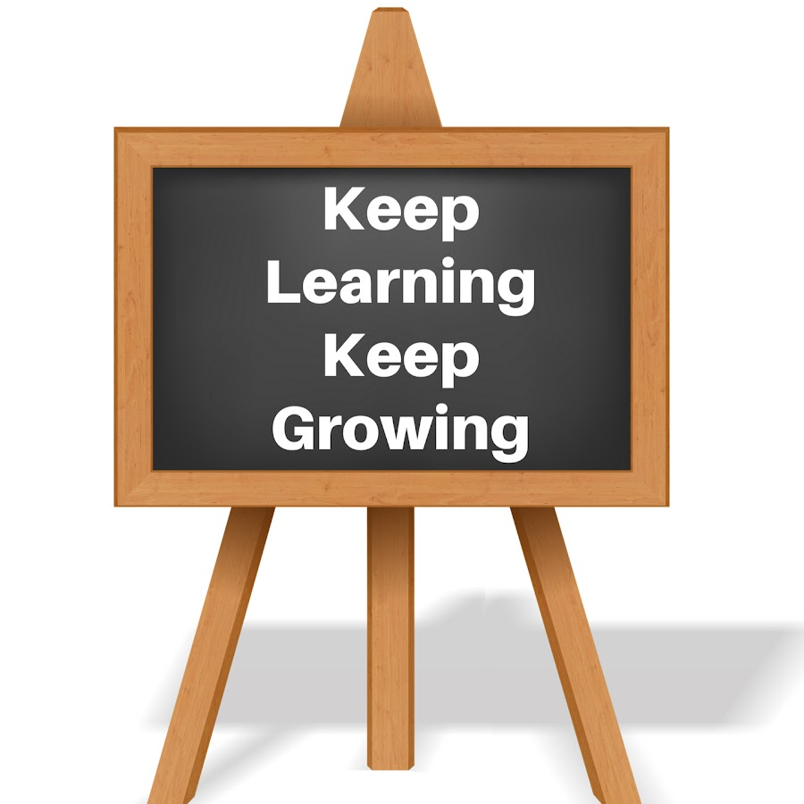
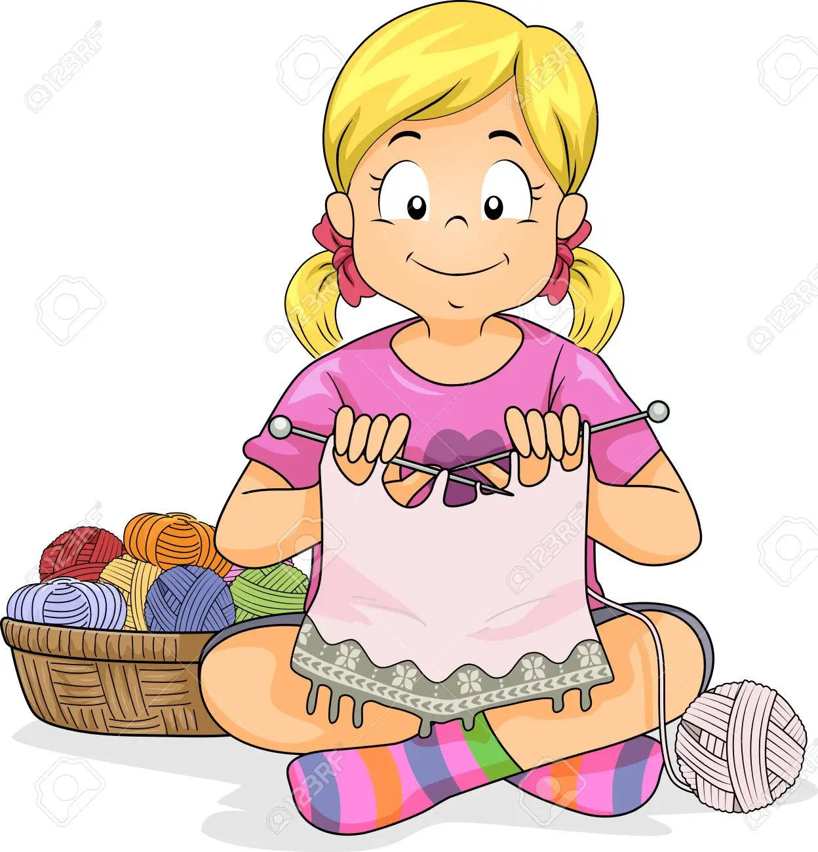
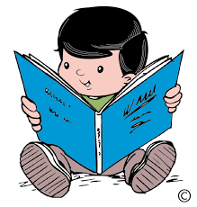
School isn’t the only place you can learn!!

Slide 7

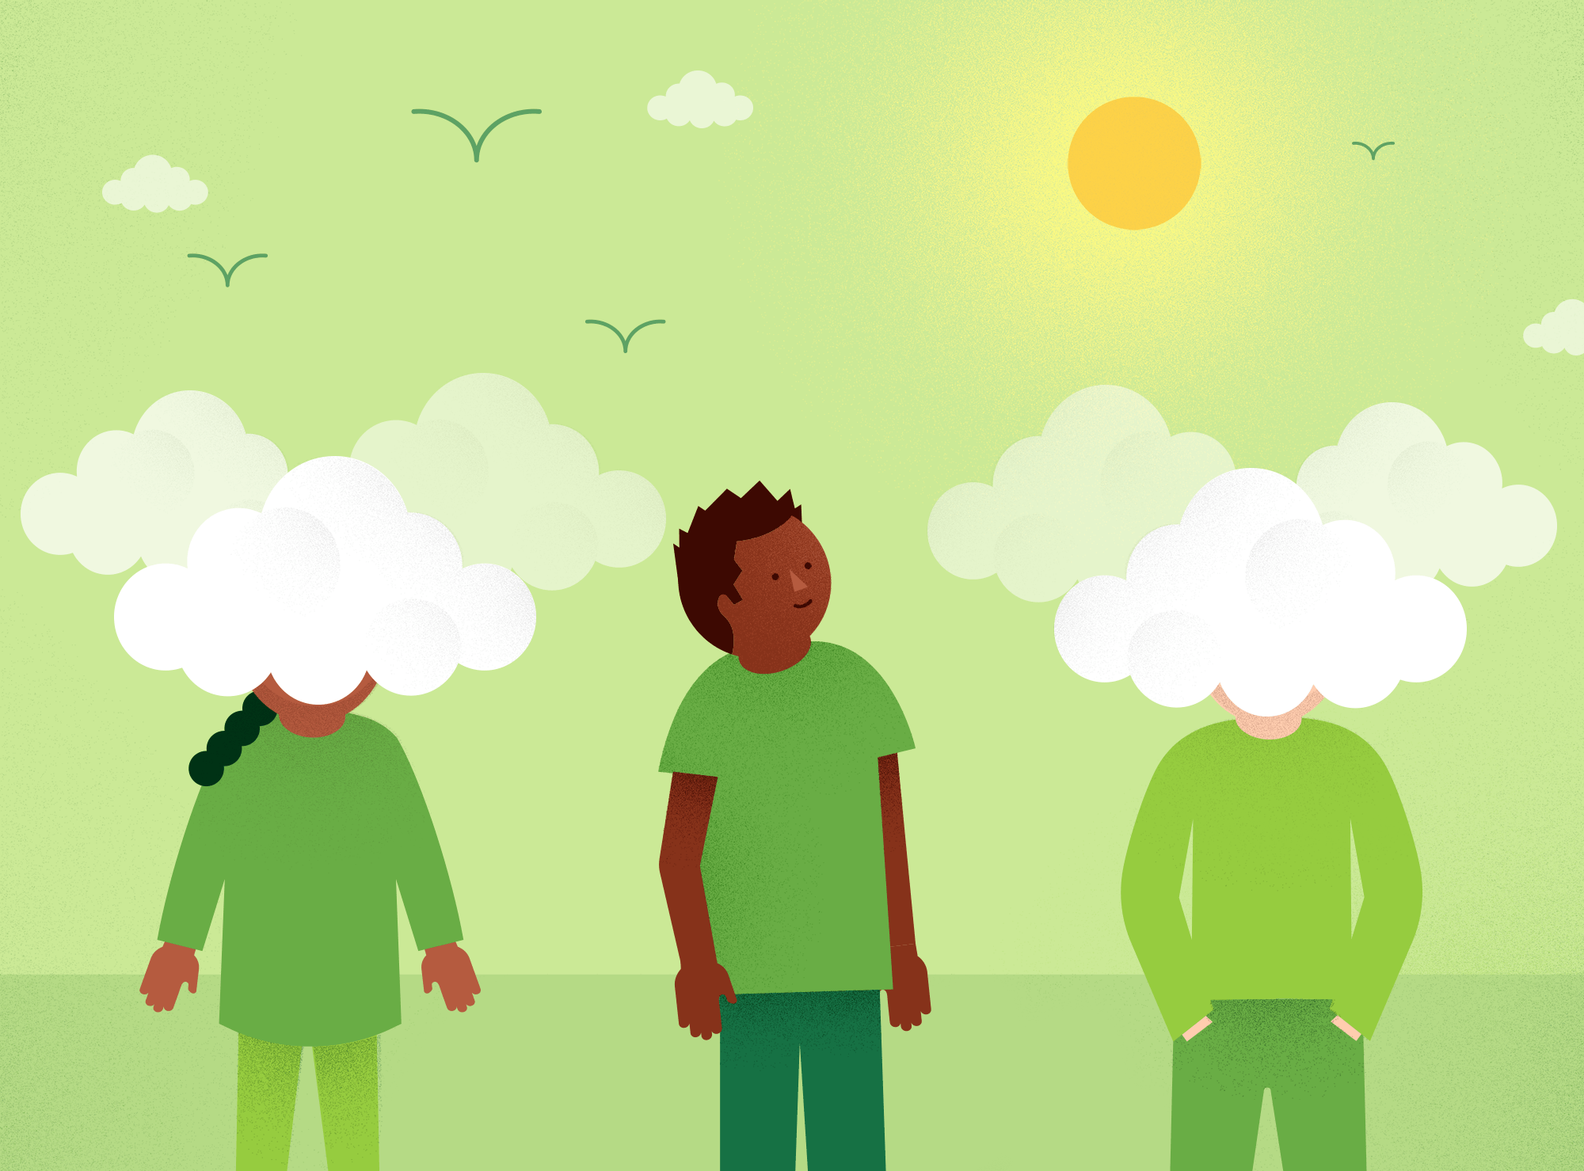
It’s important to take notice so that you are aware of your surroundings.
Explore your senses
Touch
See
Smell
Taste
Hear
Be in the present, not the past or the future, just the here and now!

